Slide 1

Class MCA – 3A
Project Name – Coffee Shop
Internal Guide – Dr. Ashwin Dobariya
Submitted By: -
Viraj Jethva – 92400584040
Harshit Varsani – 92400584039
Yash Nageshree – 92400584185

Slide 2
Project Details: -
Synopsis: -
This project is a mobile-based Coffee Ordering System developed using Android Studio
(Java + XML) and SQLite Database. It is designed to allow:
Users to log in, view a coffee menu, select items, adjust quantity using +/– buttons, and
view their bill.
Admins to securely log in and manage (add/update/delete) menu items stored in a
local database.

Slide 3
Project Description:
The Coffee Shop Project is a simple and user-friendly system designed to make the process of ordering
and managing coffee easier for both customers and the shop owner. Customers can view the menu,
select items, increase or decrease quantities using (+/–) buttons, and place their orders quickly.
The system automatically generates the bill, showing all ordered items with their prices and total amount.
On the other side, the admin can easily add, update, or delete coffee items from the menu, making
management smooth and flexible.

Slide 4
Description of Each Module in Detail: -
1) MainActivity (Home Page)
Contains buttons for User Login and Admin Login.
Navigates to respective login pages.
2) UserLoginActivity
Login with any username & Password
Navigated to the menu page after validation.
3) AdminLoginActivity
Login with any username & Password
Navigates to the Admin Panel if login is valid.

Slide 5
4) AdminPanelActivity
Admin can:
Add a new item (name, price)
Update existing items
Delete items from list
Uses a ListView to show all items.
5) MenuActivity
Each item has:
Coffee name
Price
+ and − buttons to change quantity
Go to Cart button shows total bill.

Slide 6
6) PaymentActivity
Shows selected items with quantities and total cost.
7) DatabaseHelper
Manages the SQLite database.
CRUD operations (Create, Read, Update, Delete) for menu items.
Used by both Admin and User parts.

Slide 7
Technical Description: -
Hardware Requirement
Component | Specification
Android Device | Minimum Android Version: 5.1
 | Recommended RAM: 2 GB or more
 | Screen Size: 5 inches or more (for UI clarity)
Computer/Laptop | Minimum 4 GB RAM, i3 Processor
 | Disk Space: at least 2 GB free for project
USB Cable | To run the app on a physical Android device

Slide 8
Software Requirement
Software | Purpose
Android Studio | IDE to build the app using Java and XML
Java JDK 8 or above | Required to compile Java code
SQLite (built-in) | To store and manage menu items locally
Gradle | Build tool used by Android Studio
Android Emulator | To test the app without a real device

Slide 9
Algorithms: -
1) User Module Algorithm
Step 1: Start the app, Display homepage with User Login and Admin Login buttons
Step 2: User clicks User Login
Step 3: Enter any username, Password Click “Login”
Step 4: Open menu screen
Step 5: Load items from SQLite database
Step 6: For each item in menu:
Show name, price, and quantity counter
User clicks + button – increase quantity
User clicks – button – decrease quantity (if > 0)
Step 7: On "Go to Cart" click:
Display only selected items
Calculate total price = sum of (item price × quantity)
Step 8: User selects Cash or UPI (optional future scope)
Step 9: Click on Confirm Payment – Display “Payment Successful” toast/message
Step 10: End

Slide 10
2) Admin Module Algorithm
Step 1: Admin clicks Admin Login
Step 2: Enter fixed credentials: username, Password Click “Login”
Step 3: If login valid - go to Admin Panel
Step 4: Admin can perform:
Add Item - insert into SQLite table
Update Item - update name/price in SQLite
Delete Item - remove item from SQLite
All items are shown in ListView with click-to-edit support
Step 5: End

Slide 11
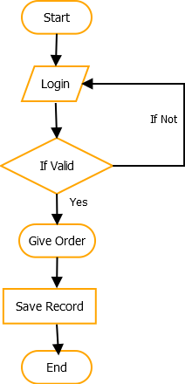
Flow Chart: -
Admin Flowchart

Slide 12
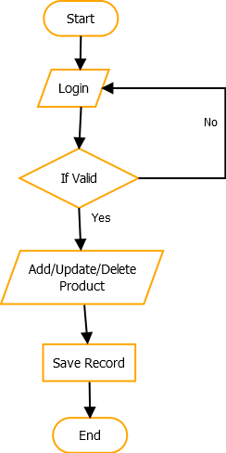
User Flowchart: -

Slide 13
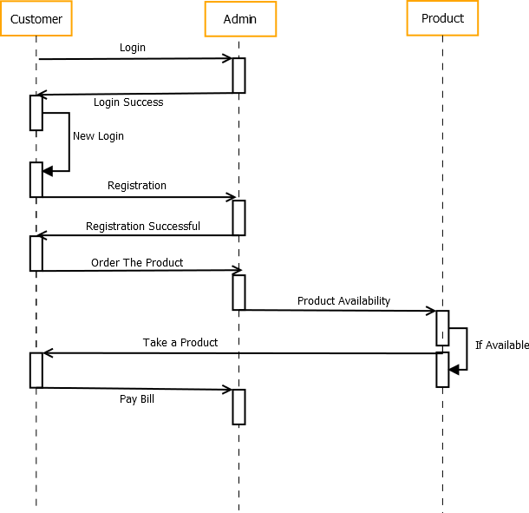
Sequence Diagram: -

Slide 14
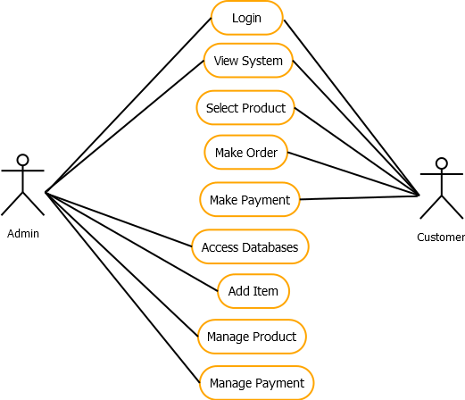
Use Case Diagram: -

Slide 15
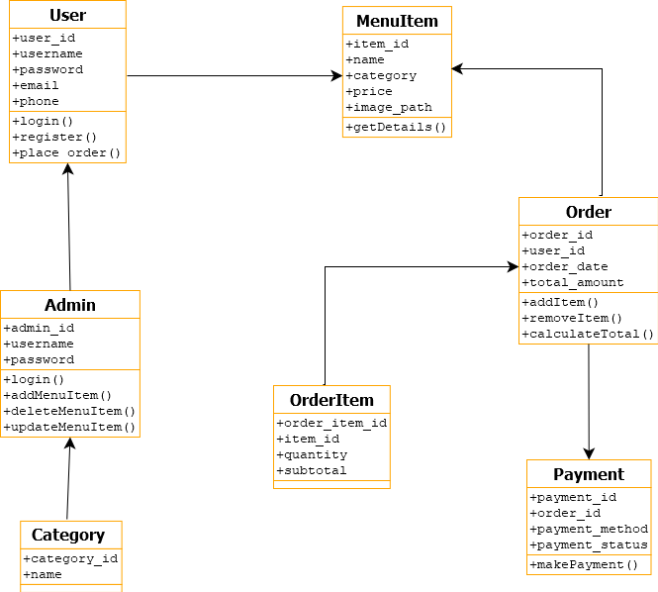
Class Diagram: -

Slide 16
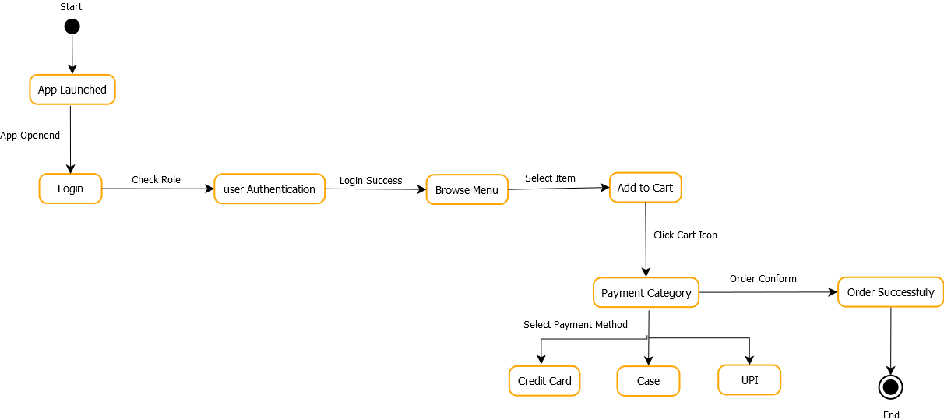
State Diagram: -

Slide 17

Data Flow Diagram: -
(Zero Level)

Slide 18
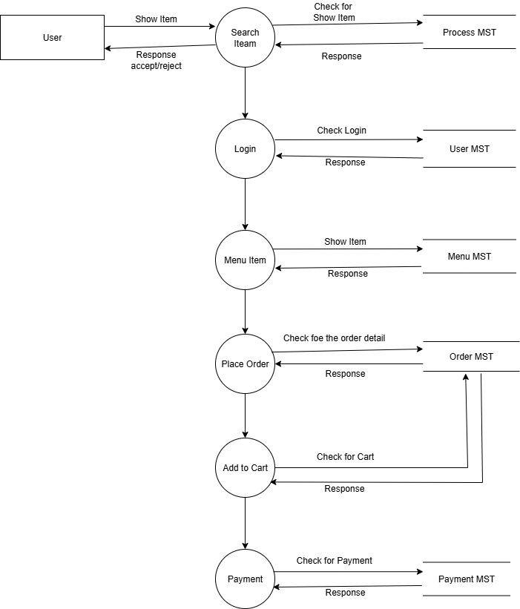
Data Flow Diagram: -
(First Level)

Slide 19
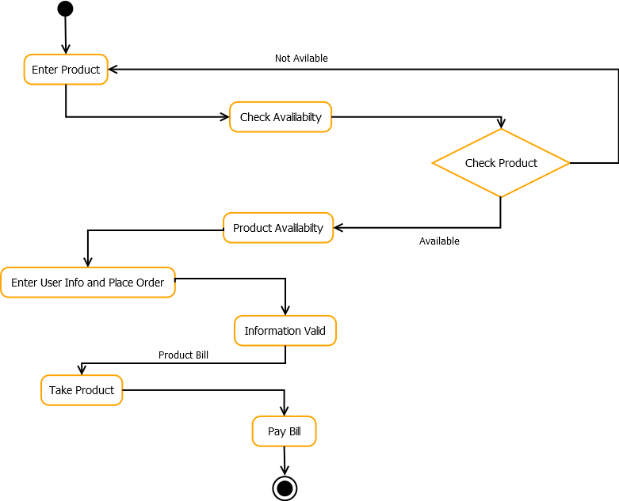
Activity Diagram: -

Slide 20
Database Design: -
Table Name: users
Table Name: menu_item
Attribute Name | Datatype | Constraints
Id | Int | Primary Key
Name | Varchar (10) | -
Email | Varchar (10) | -
Password | Int | -
Attribute Name | Datatype | Constraints
Id | Int | Primary Key
Category_id | Int | -
Name | Varchar (20) | -
Price | int | -

Slide 21
Table Name: orders
Table Name: category_table
Attribute Name | Datatype | Constraints
Id | Int | Primary Key
User_id | int | -
Item name | Varchar (100) | -
Quantity | Int | -
Attribute Name | Datatype | Constraints
Id | Int | Primary Key
Name | Varchar(20) | -

Slide 22
Table Name: order_status
Table Name: admin
Attribute Name | Datatype | Constraints
Id | int | Primary Key
User_id | int | -
total | int | -
status | Varchar (10) | -
Attribute Name | Datatype | Constraints
Id | Int | Primary Key
Username | Varchar(50) | -
Password | Varchar(50) | -

Slide 23
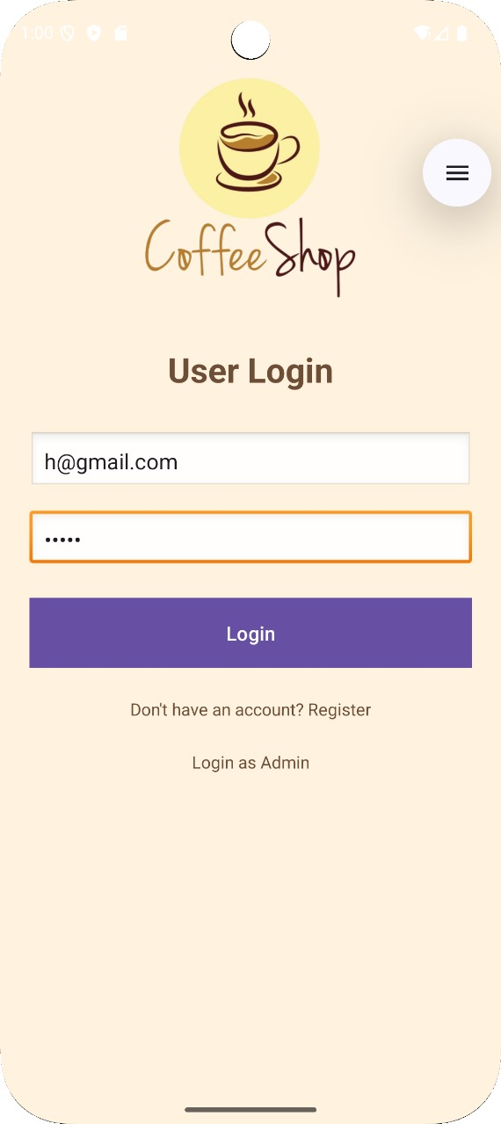
Screen Design:
1) User Login: -

Slide 24
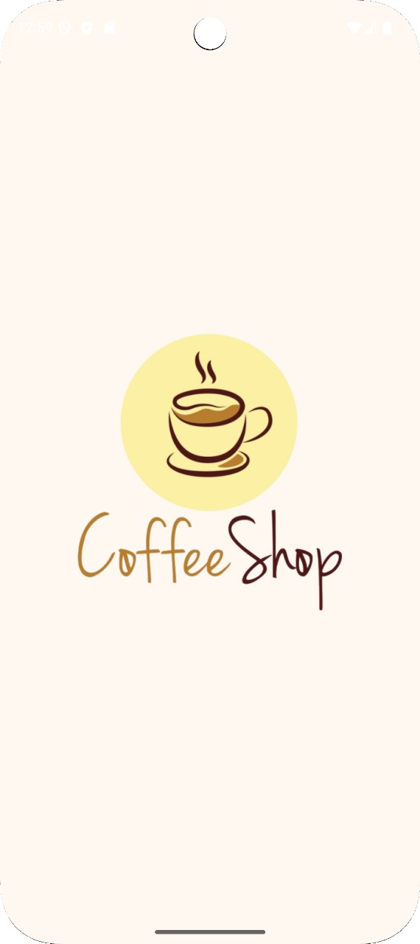
2) Splash Screen: -

Slide 25
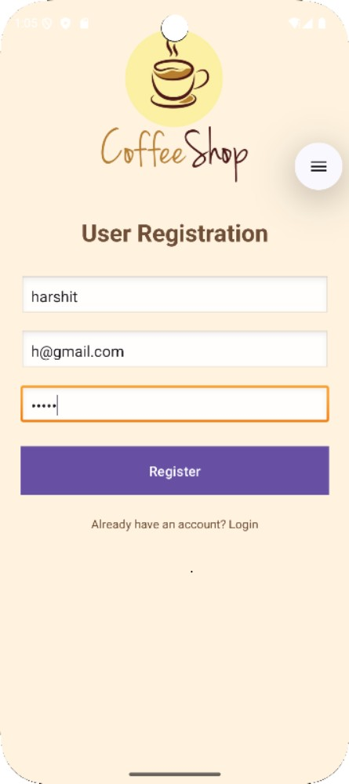
3) User Registration: -

Slide 26
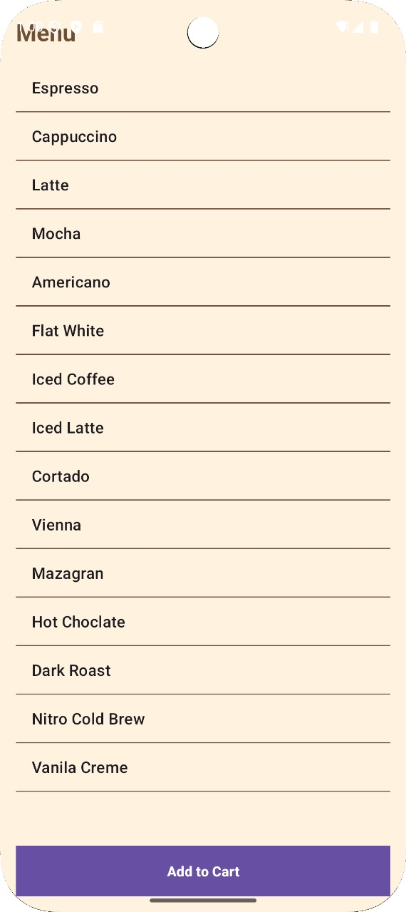
4) Menu Item: -

Slide 27
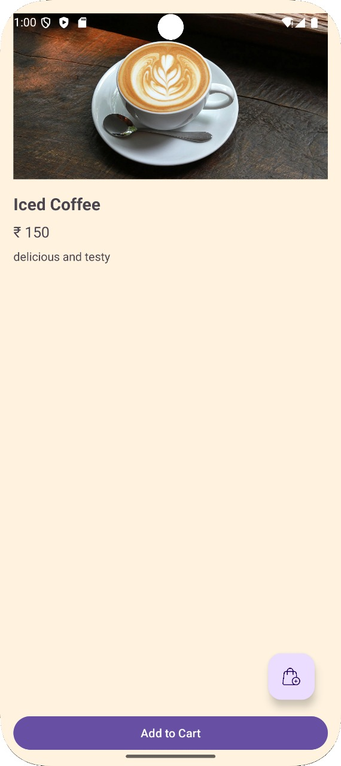
5) Item Detail: -

Slide 28
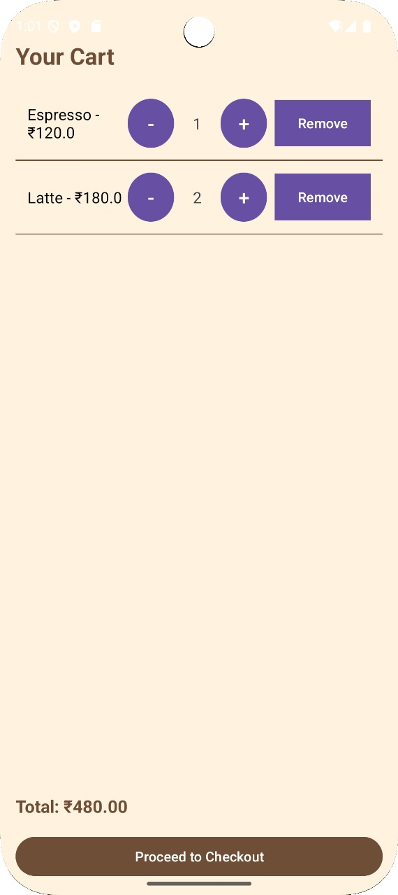
6) Your Cart: -

Slide 29
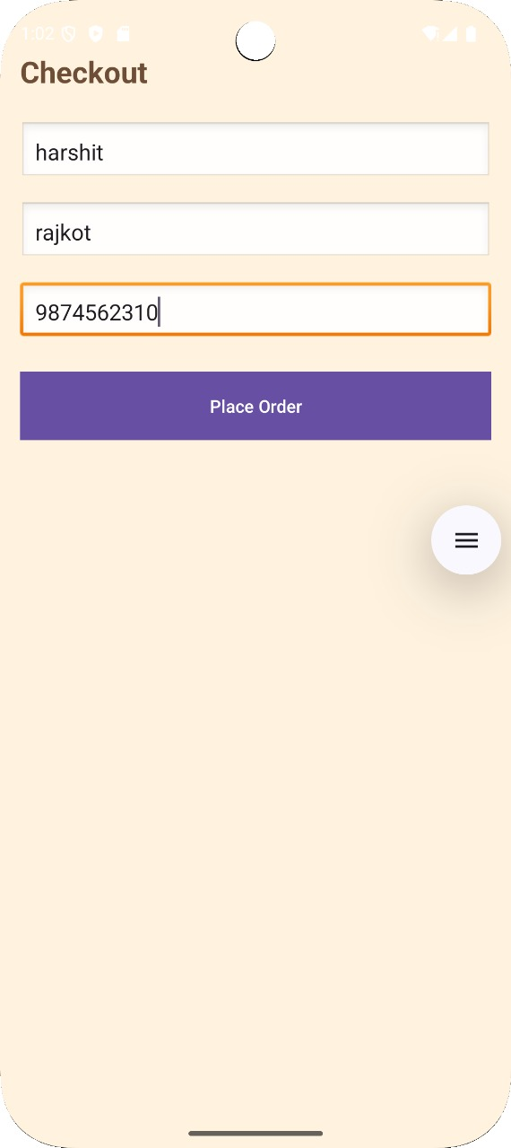
7) Check Out menu: -

Slide 30
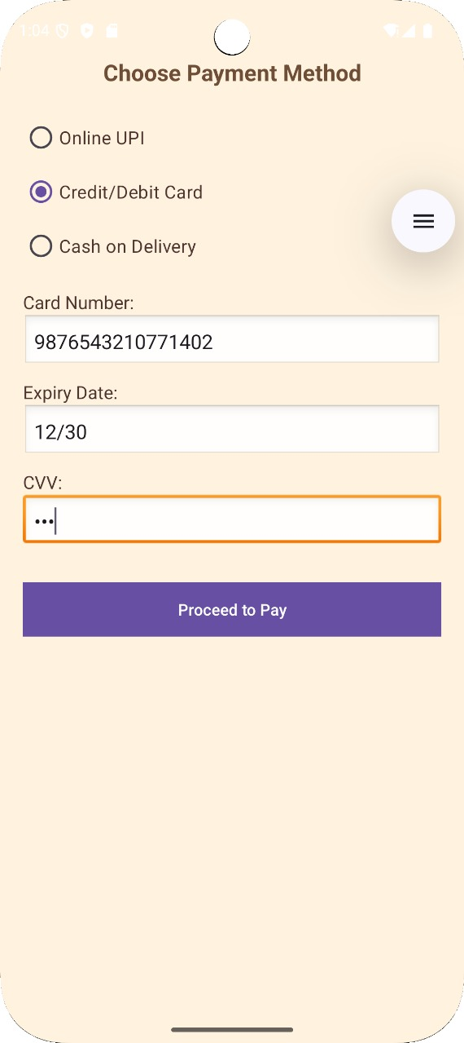
8) Make a Payment: -

Slide 31
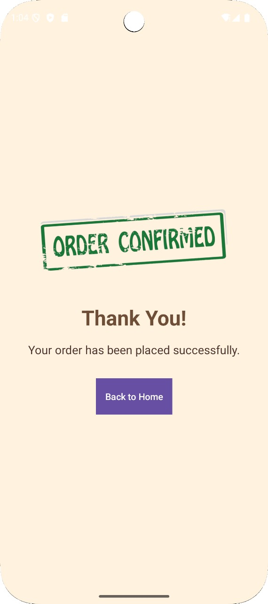
9) Order Conformation: -

Slide 32
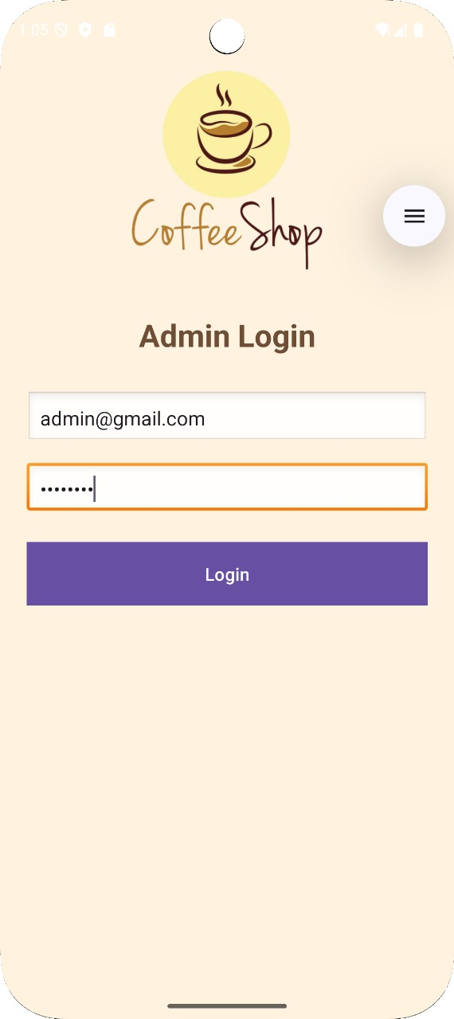
10) Admin login: -

Slide 33
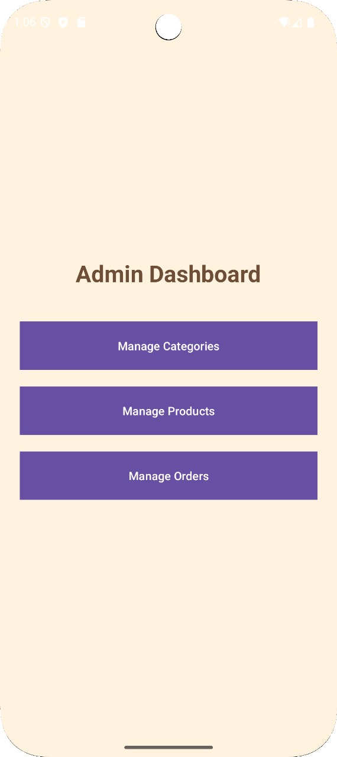
11) Admin Dashboard: -

Slide 34
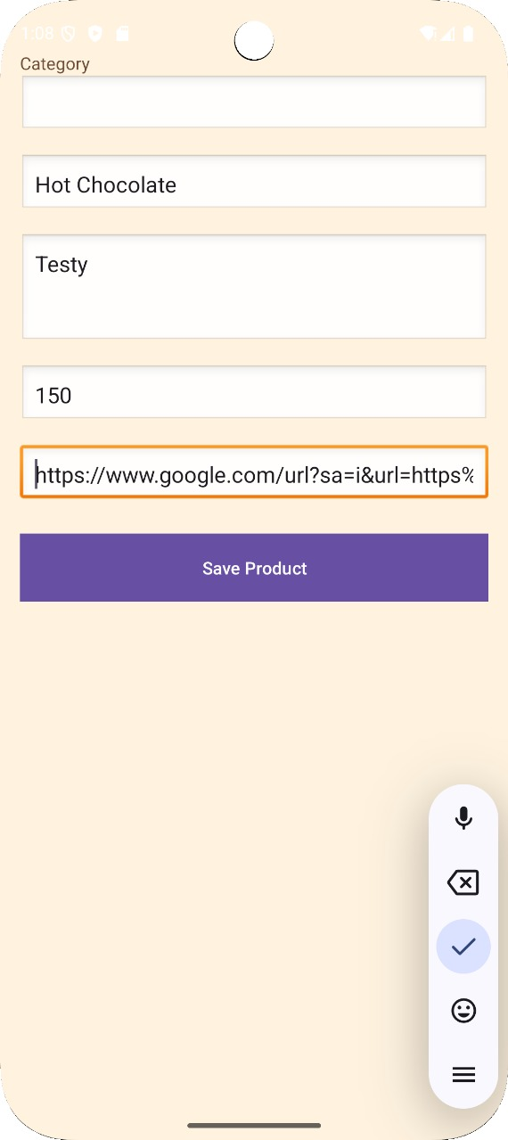
Add item Page: -

Slide 35
Conclusion:
This Coffee Shop app project allows users to browse different coffee items, add them to a cart,
and make orders easily. It demonstrates basic app functionalities like user login, admin login,
database connection, item management, and a smooth user interface. Overall, the project shows
how an online ordering system works in a small business, providing convenience to customers
and helping shop owners manage orders efficiently.

Slide 36
THANK YOU

